Slide 1
Networking Basic
Linux with VirtualBox

Slide 2
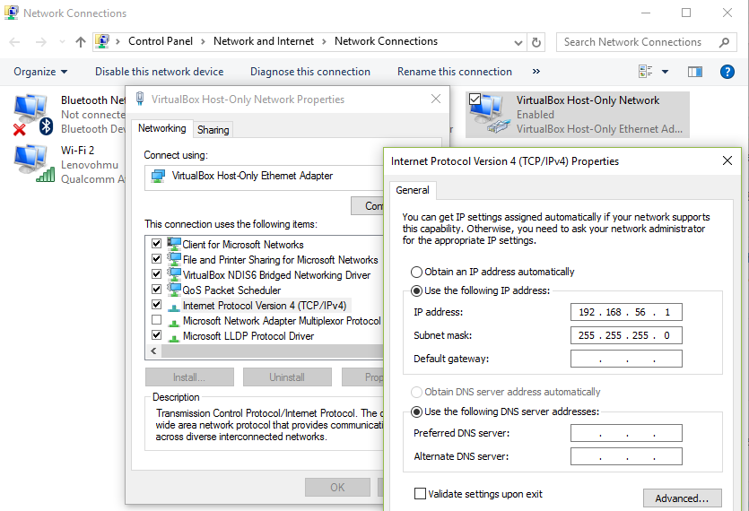
Konfigurasi Host Only di OS HOST

Slide 3
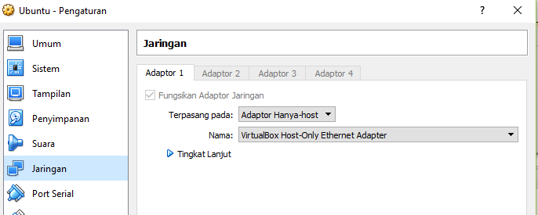
Konfigurasi Pengaturan Perangkat Jaringan

Slide 4
Perintah Dasar Jaringan
Ifconfig –a
/etc/network/interfaces
/etc/init.d/networking restart

Slide 5
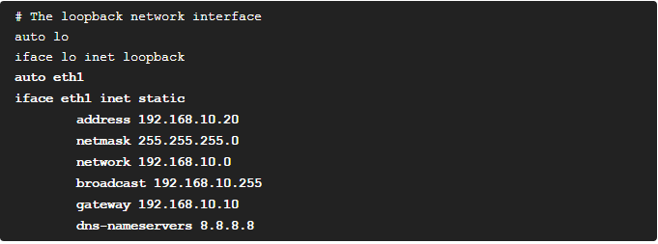
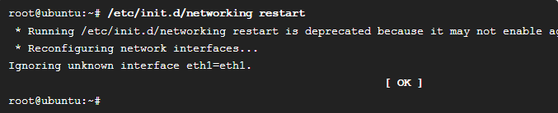

Slide 6
